Slide 1

Recognise this?
Notes:
Who recognises this? I’m sure it’s a scene you are all familiar with. Large lecture theatres full of students, a result of rapidly increasing class sizes. At UQ, now with approximately 50,000 students, are class sizes have really expanded and tutorials and small-group teaching is becoming increasingly important.

Slide 2
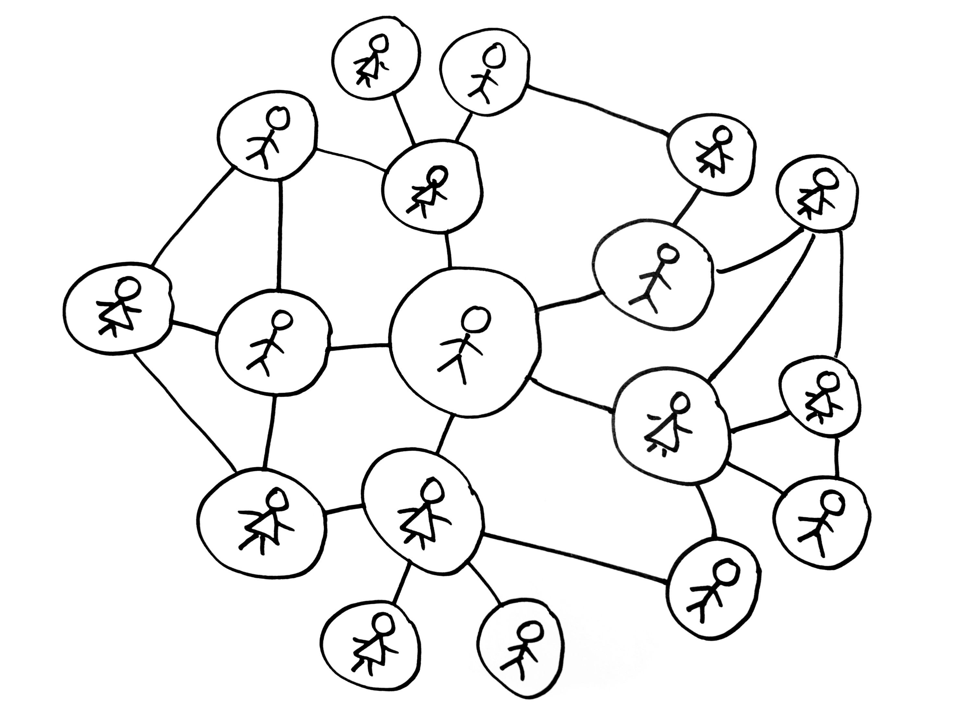
Tutors@UQ
Emma Bartle
Kelly Matthews
Julie Duck

Slide 3

Tutors@UQ is…
offered every semester
interactive 5hr program
centrally co-ordinated
multi-faculty
of 10
Notes:
Offered every semester for new tutors
5 interactive hours spread over the

Slide 4
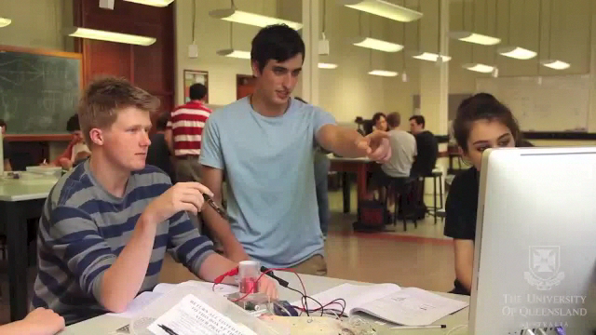
It looks like…
of 10
Notes:
University’s largest teaching and learning professional development program, and about 600 tutors complete the program each year

Slide 5
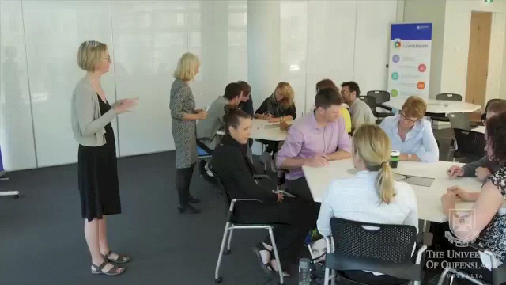
How it works…
of 10
Notes:
Co-facilitated
Framed around guiding questions
Activity-based
Connected to real world
Encourages reflection

Slide 6
How does it work for UQ?
Tutor
School
School
Tutor
Tutor
Tutor
Tutor
Tutor
Tutor
Tutor
Tutor
Faculty
School
School
Tutor
Tutor
School
Tutor
Tutor
Faculty
Tutor
School
Central T&L unit
Each year:
6 Faculties
40 Schools
>600 new tutors
Tutor
Tutor
Collaborative partnership model
of 10

Slide 7

What’s needed to keep it working?
Tutors
50% from DVC office
50% from faculty
of 10

Slide 8

How do we know it works for UQ?
Every faculty is engaged
Won institutional teaching award
Sustained for 5 years
Survived a restructure of the L&T unit
of 10

Slide 9
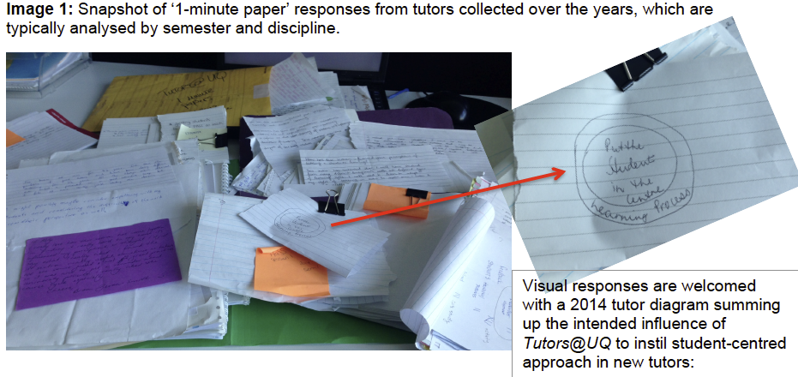
How do we know it works for tutors?
I feel more confident, more capable of connecting with and inspiring students. I have ideas of how to actually practically go about doing that I would otherwise not have had (Arts tutor, 2011)
of 10

Slide 10

Here’s what our tutors have to say…
of 10

