Slide 1


Kellyann Geurts
Senior Advisor Learning & Teaching
College of Design & Social Context
kellyann.geurts@rmit.edu.au
Notes:
My good practice example is the Connecting Sessional Staff program in the College of Design and Social Context, providing coherent and tailored support for sessional staff in seven Schools.

Slide 2

timely, practical professional learning for sessional staff in seven schools
of 10
Notes:
what it is
The project began in 2013, our objectives were to:
Address learning and teaching needs
Share, present, discuss and reflect on teaching and learning experiences
Connect with personal and professional learning networks across the University
Link to the online modules from the Professional Development for Tertiary Teaching Practice (PDTTP) program designed for sessional staff.

Slide 3
Lecturing - Providing career advice to students - Course preparation, towards the outcome of course coordination - Incorporating RMIT workshop and material/technology facilities - Overseas studios - Assignment and test marking - Preparing classes - Combining technical and academic knowledge - Black Board skills and knowledge - some of the finer points - Smart boards - how to use and integrate into lectures - Overview on the various avenues for assistance both administrative and teaching/research student centered learning teaching with technology preparing classes - Teaching with technology - Action learning - Peer review (students providing feedback to other students) innovative teaching skills; assessment; and new technology use as teaching aid - I am interested in aligning online delivery or support (ie blackboard) with my face to face teaching in a way that enhances student experience without creating the sense that it is INSTEAD of coming to class - Language Numeracy Literacy - Managing competing demands/needs of students - Managing dominance by students - More inclusive/interactive sessions - Use of incorporating technology, example embedding YouTube's into PowerPoint slides or using my IPad in some classes to share material rather than RMIT computer - Being resourceful when you have not IT - Managing cultural diversity where students have extremely little English -Being efficient in providing feedback (matter of skimming through?) Inclusive teaching - for blind students and physical disability Interpreting, translating, cultural aspects and social values - Technology in the classroom motivating students managing class time group activities - Incorporating new ICT into teaching and learning, developing professional writing skills in my students cultural diversity and inclusive teaching, and teaching to diverse groups in general (e.g. different abilities, professional streams) - using the learning space more effectively/creatively - Student Centered Learning; Cultural Diversity; and Flexible Assessment - Managing cultural diversity - Teaching in new learning spaces - Teaching with technology - On-Line learning - Work Integrated Learning - Team teaching across subjects - Teaching with Technology - Work integrated Learning - Teaching in new learning spaces - Developing better techniques for working with international students - Student centered learning teaching with Technology - Offering flexible assessment - Blackboard Assessment, student centered learning, encouraging participation esp. with international students - How to cope with mental health issues within the class room? - How to cope with students who need individual tuition within a group class? - Integrating online and Face-to-face streams to be one stream - Developing a toolbox of technology to support online engaged learning (then using those tools in the course) - Developing a scaffolding approach to support online engaged learning (not distance learning) -Preparing assessments/ writing briefs - Teaching with technology to optimise class time - Working with students to encourage attendance and time management of assessments- motivating students- Rubrics - preparing classes and identifying and delivering upon key learning objectives for students - Rubric writing - managing cultural diversity practicing inclusive teaching - Etching with technology - more use of projectors/electronic whiteboards for group critiques -Teaching in spaces with facilities for cardboard model making to further develop conceptual models -Real world resources and learning based on industry best practice online education - strategic use of technology Student Centered Learning, Course design, - Managing group work challenges (shared contributions and shared marks) -- Teaching students with major English language problems - Developing topics for group assignments work integrated learning - Peer assessment - Kinesthetic learning - Working in new learning spaces (online) - Engaging with students - Making classes as interesting as possible - Teaching 'worthwhile' material - Using technology effectively - Student centered learning - Feedback - Time management and teaching, especially for: marking, tutorial preparation and lecture preparation - Improving re-employment and long-term teaching career prospects (because this does improve teaching) - Use of online learning spaces such as Blackboard - Conducting student group tutorials / critiques - Managing cultural diversity - Managing DLU - Understanding how to help students that are of lower skill level - Attitudes and approaches to integrating students fresh from High school into University learning - Teaching in learning specs - Curriculum development - Team teaching - Working with Electronic Whiteboards inclusiveness, feedback, - Expanding use of technology for greater efficiency - Better all-round PD to counter 'sessional' isolation - Increased connections to other course in my area - Working with difficult students and managing the difference between mature age students and school leavers - Providing feedback - How to motivate uninterested students - Lecturing skills development inclusive teaching - curriculum planning, knowing about teaching resources and current pedagogical knowledge - Developing expertise in a wider range of courses; eg have mainly taught Numeracy but also interested in Teaching and Learning etc - Teaching: interest is in flexible, collaborative approaches and student involvement - Working collaboratively in a team... how to connect with full time academics to get this happening regularly - Promoting class discussion - Making tutorials engaging e-Learning - Broadening scope of teaching - Technology available to staff - Ensuring students are engaged - Developing their skills - Giving better feedback - Time management during class & preparing classes - Writing course material/project briefs - online History and Theory - Communication Technology - Using technology - Preparing classes (differences across different levels) - It would be great to be able to use all the technology on offer in the new rooms networking and becoming part of a team - Having access and knowing administrative staff so every day problems can be solved eg. Rooms double booked - Enhancing teaching with technology - Career paths for sessional lecturers - Developing positive relationships with adult students - Student centered learning with large classes - Scaffolding students with low literacy into university level study ; feedback and assessment - Providing feedback and future direction - Development of assessment tasks and criteria - New ways of classroom engagement utilising on-line tools for assessment and learning - Lecturing to large groups - how to use technology - Improving student participation in discussions - Providing feedback - Improving a technological approach to teaching - The psychology behind effective learning and teaching - How to develop more effective team work among students - How to get poor/uninterested students to do more work - Knowledge of 3d printing and the use of the myriad of sophisticated machinery the school now has at it's disposal - Enhancing student engagement - Alternative teaching methods - Activity based learning - Preparing classes test - Alternative assessment methodologies - Integration of cross-disciplinary teaching/learning - Further refinement of course development/planning - new technology - better handle on technology - working with blackboard - New teaching technologies , online teaching strategies, collaborative methods in teaching - Online assessment - Dealing with late submissions - Dealing with students with English as their second language - providing constructive feedback and criticism, providing lively discussions and group activities in class - Using available technology in the classroom - Strategies to assist students with anxiety or mental health issues - Learning habits of adults and teaching methods accordingly - Catering to newly graduated high school students vs. mature age students - Characteristics of gen y vs. gen x, and difference in teaching methods for both - Course planning - Assessment methods - Blackboard - New and existing technology resources available in the faculty. (Robots, 3d printing etc.) - Teaching techniques for developing strong class discussion / student self critique - Use of technology - teaching and learning tools, links to assessment - Feedback - embedding in teaching, learning and assessment - Thinking Cultures - routines, reflective practices - Use of Blackboard - Preparation of teaching material - Assessment of students individual ability early in the semester via Development of my own materials to compliment the topics covered by the course - More effective communication in terms of explaining ideas, assessment requirements and related issues - Interactive teaching - Time management - ie: not spending more than the allotted marking time - It's sometimes impossible! - offering flexible assessment teaching with technology practicing inclusive teaching - Reviewing students, Student encouragement, technology - I would like to know more about some of the new technology in building 80 - Structure of lecture Curriculum / Design Creative methods of presentation Teaching with technology - Managing cultural diversity - Practicing student centered learning - Offering flexible Assessment - Strategies to quicker manage assessment and feedback (eg I have heard that self-assessment can be advantageous but don't know how to go about this). - Strategies for group projects and assessments in class (all of my learning experiences as a student were individual solo work, as has been most of my teaching experience) - Developing programs for sessional staff to convert studio/teaching outcomes into research inclusive teaching, student centered learning, cultural diversity - Producing and using excel spreadsheets for marking - Advanced use and potential of blackboard - What teaching resources are available and how to access them? - Preparing lecture notes, managing marking loads, time management - Preparing classes, time management during class, practising - new learning ideas - Running a tutorial - Teaching students with disability (intellectual and/or physical) - Cultural diversity - Building teaching and learning resources for adult learners - Assessing authentic learning - Planning for different learners with one assessment task - Providing feedback - Using more of the electronic whiteboard and associated software - Effective writing of comments on assessment pieces - Promoting an interactive classroom setting
what sessional staff want
of 10
Notes:
How it works: Suggest 3 dot points maximum
An initial short online survey determined areas of greatest need amongst sessional staff.
Over 20 sessional staff joined the steering committee to help summarise the needs and develop the program

Slide 4
of 10
Notes:
Responses summarised to identify teaching practices sessional staff would like to develop further…
A series of events, from whole of College symposia to tailored school-based workshops and online resources, were designed to meet these needs
Priorities were aligned with University strategic directions, including teaching in new learning spaces, inclusive teaching and supporting the professional learning of sessional staff.

Slide 5
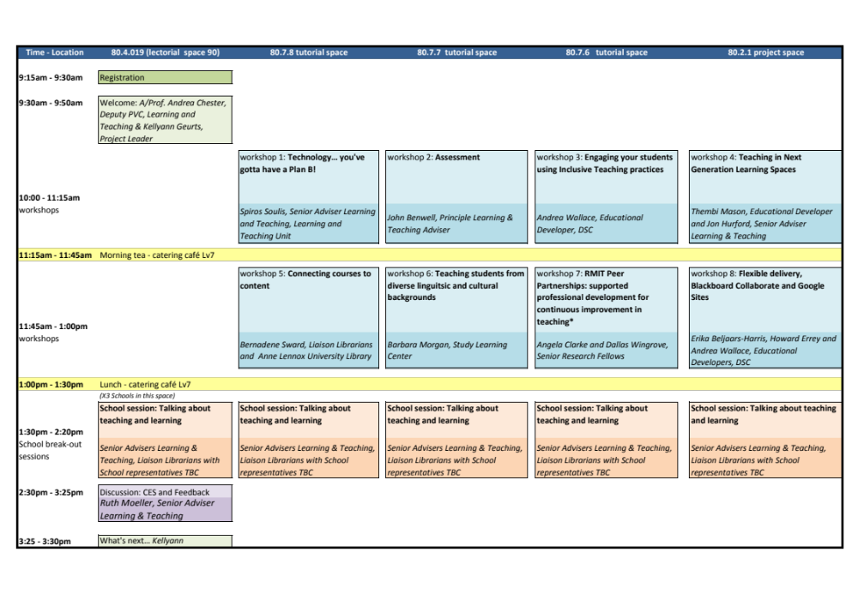
of 10
Notes:
Full day Symposium program
What worked:
Parallel sessions to allow choices,
School sessions for local discussions
dedicated academic development staff in collaboration with School Deputy Deans L&T, School Liaison Librarians, Study Learning Centre, Office Dean L&T

Slide 6
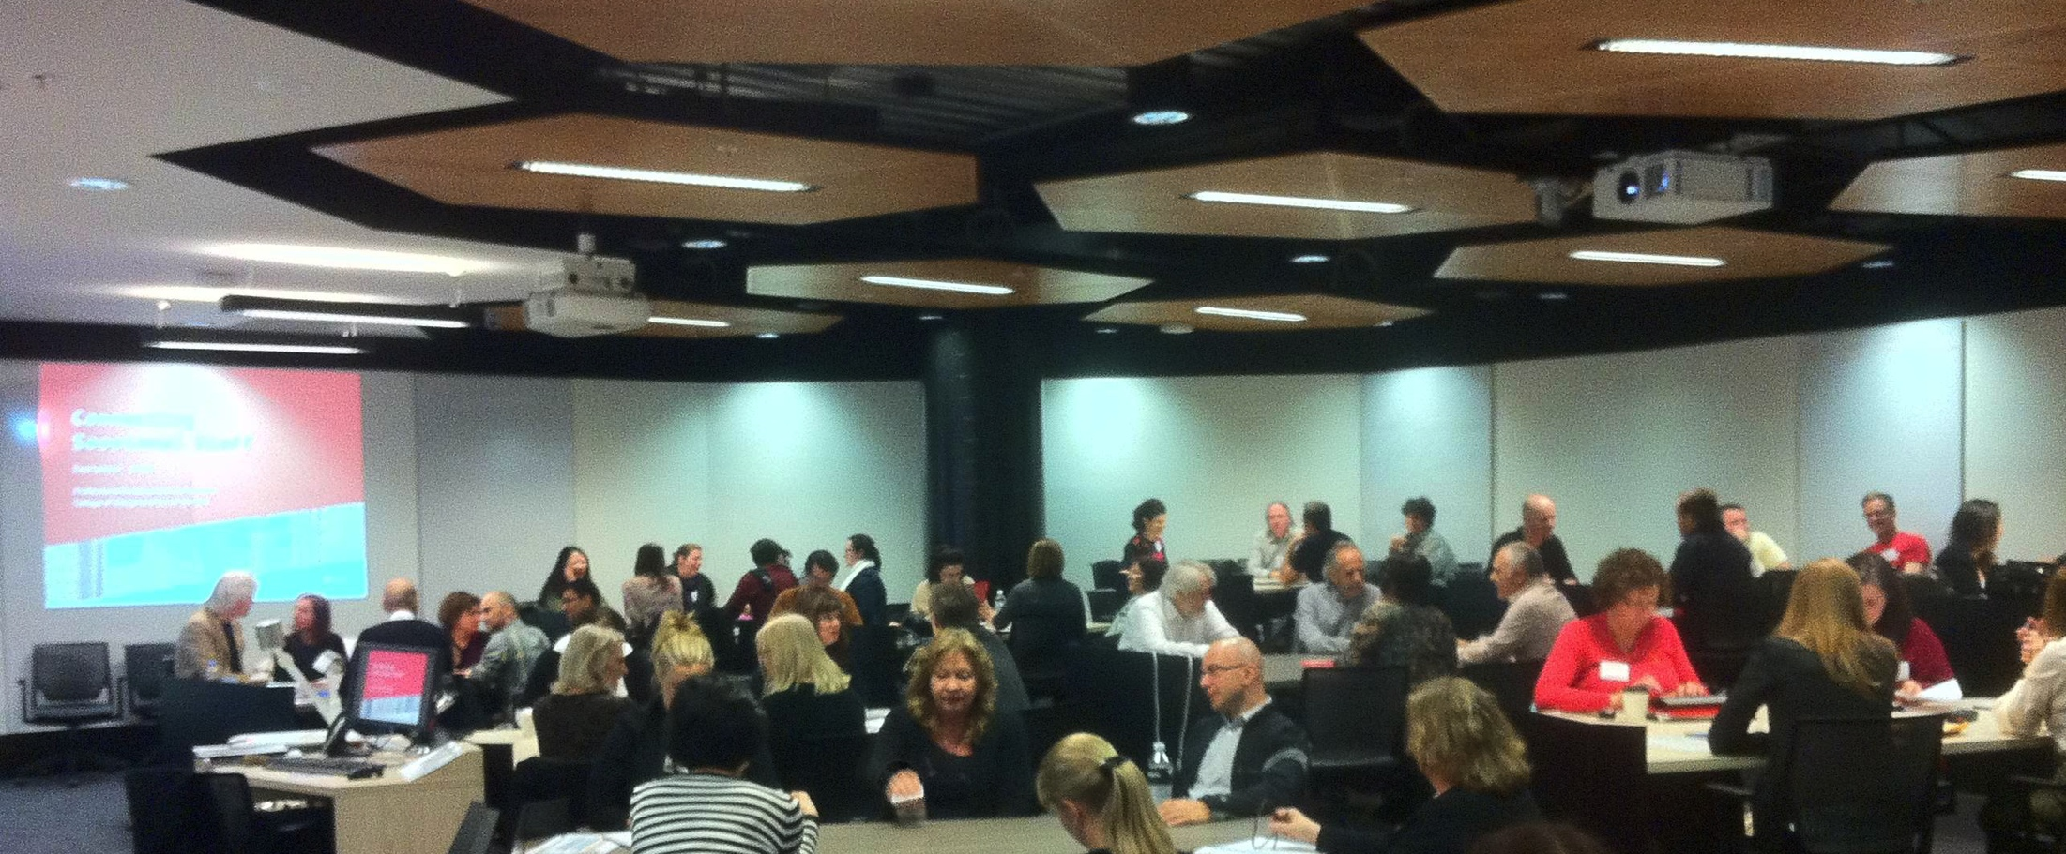
of 10
Notes:
critical success factors
Face to face delivery in collaborative teaching spaces
Tables arranged by school to make the early introductions to ongoing support team
committed sessional staff steering committee to develop and evaluate the program
University support to pay for sessionals staff to attend the events

Slide 7
positive outcomes
over 400 sessional staff engaged
over 24 months
one full-day and one half-day symposium
3 induction events
Sessional Staff Essentials website: www.rmit.edu.au/dsc/sessionalstaff
of 10
Notes:
positive outcomes
Over 400 sessional staff engaged
Over 24 months
Full and half day symposia and induction events
new online handbook - Sessional Staff Essentials: www.rmit.edu.au/dsc/sessionalstaff to address many of the recommendations developed by sessional staff steering committee
schools committing to and others showing interest in taking a coordinated approach to support professional development needs of sessional staff
Established further university funding this year (taking the project into it’s 3rd year)
Commitment to ongoing College-wide induction sessions

Slide 8
resourcing
$
Payment to sessional staff generously funded by the Office of Dean L&T
Prioritising this initiative to promote the University’s Sessionals in Tertiary Teaching Practice online modules http://www1.rmit.edu.au/staff/professionaldevelopment/ttp/sessionals
of 10
Notes:
Resourcing needed
Payment to sessional staff generously funded by the Office of Dean L&T
Prioritising this initiative to promote the University’s Sessionals in Tertiary Teaching Practice online modules http://www1.rmit.edu.au/staff/professionaldevelopment/ttp/sessionals

Slide 9
challenges
7 schools, 1200 sessional staff
determine Schools’ future needs with BLASST tool
develop sustainable systems & processes
administration of the payments!
of 10
Notes:
Challenges
Meeting a wide range of professional development needs from over 1200 sessional staff across seven schools
determine Schools’ future needs using the BLASST interactive tool (scheduled to meet together start of May)
Work together to develop sustainable processes in place to provide ongoing support for sessional staff at RMIT University
Managing the administration of payments!

Slide 10

evidence of success
of 10
Notes:
Evidence of impact/ success
an overwhelmingly positive evaluation of each event – used to feed forward. Some examples of general comments:
"Thank you very much for this PD opportunity. It was very positive and supportive. You thought about us and our needs as sessionals and you paid us too!"
"It was FANTASTIC to get structured, face-to-face professional development - it would be great to get continued support like this to better our teaching practice and the experience of our students"
"This is an excellent initiative that recognises the contribution and commitment we make to RMIT"
“5 stars for delivering the best sessional staff symposium ever!”

