Slide 1
Faculty of Business and Economics
Sessional Academic Staff Unit
Dr Gordon Brooks Linda Carlaw
Head of Department Administrator
Contact:
gordon.brooks@mq.edu.au
linda.carlaw@mq.edu.au

Slide 2



Good Practices
Supporting sessional staff through a dedicated Sessional Academic Staff Unit. Among other things we undertake:
Faculty-based sessional staff induction
Negotiating long service leave
Subsidised parking

Slide 3
Good Practices
What is it? | How does it work?
Induction | All new sessionals attend a 2 hour paid induction session. We cover a range of topics such as payroll, IT set up, campus facilities, policies and resources available.
Long Service Leave | Sessionals with 10 years continuous service are entitled to long service leave. SASU & HR have been working together to establish an application process and gather evidence of work history.

Slide 4
Good Practices
What is it? | How does it work?
Subsidised Parking | Sessionals who teach a minimum of 48 contact hours across the year are entitled to receive a 50% reimbursement of the cost of an annual campus parking permit. Claims are processed by SASU.

Slide 5

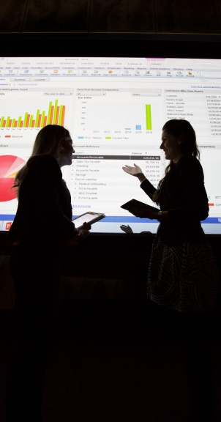
Critical success factors
Induction - communication to identify new staff
LSL - support from HR
Subsidised parking - budget and processing
Chris Stacey, Macquarie University

Slide 6


Positive Outcomes
Induction
New staff feel welcome
First day nerves are
alleviated
Long Service Leave
Recognition & reward for
commitment to Macquarie
Opportunity for staff to take
paid leave
Parking Reimbursements
On campus costs are reduced
Token of appreciation

Slide 7

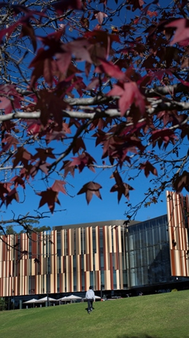
Resources
Induction – budget for paying Sessional staff
LSL – commitment of time from SASU and HR to develop individual applications
Subsidised parking - budget
Chris Stacey, Macquarie University

Slide 8



Challenges
Conducting inductions at times when sessionals are available.
Sourcing evidence of teaching history. Payments vs when they were working.
Subsidised parking is pretty well sorted!

Slide 9


Success
In 2014 SASU inducted 57 new sessionals. In 2015 SASU has inducted 33% of all sessionals working this session.
Since January 2014, 3 Sessional Staff have received long service leave. Further applications are in progress.
In 2014 we processed 65 parking reimbursements valued at over $10,000.

Slide 10
Thank you

