Slide 1

Blasst – Good
Practice Presentation
Whole of Institution Support
for Sessional Staff Category
Carolyn Barker AM
Chief Executive Officer
Endeavour Learning Group
www.endeavour.edu.au

Slide 2
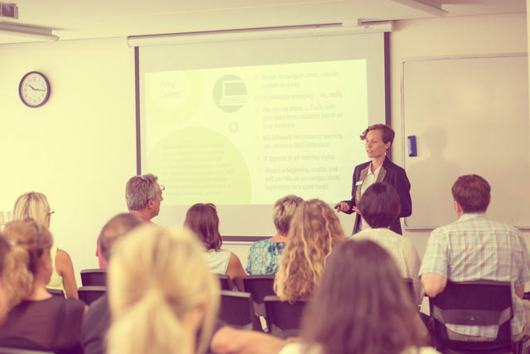
Building brand ambassadors.
of 10

Slide 3
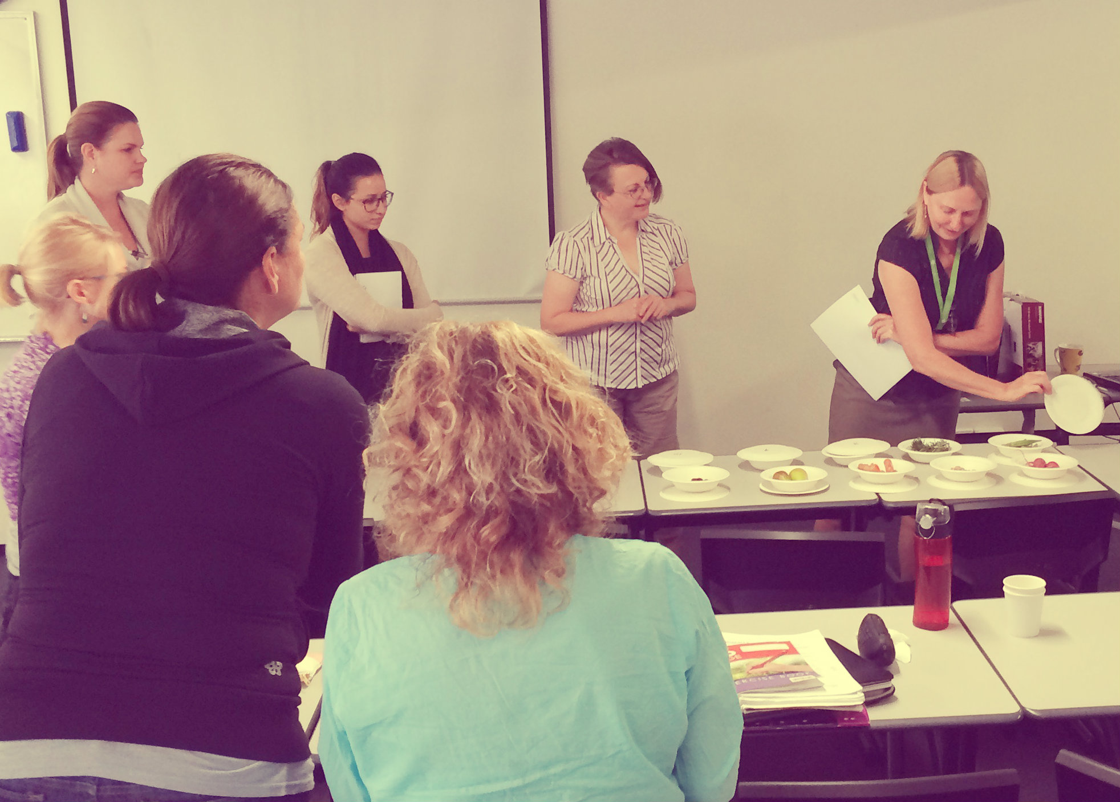
Aligning purpose and values.
of 10

Slide 4

Communicate,
communicate,
communicate.
of 10

Slide 5
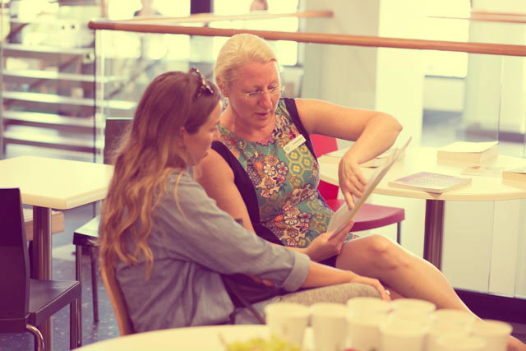
Critical success factors.
of 10

Slide 6
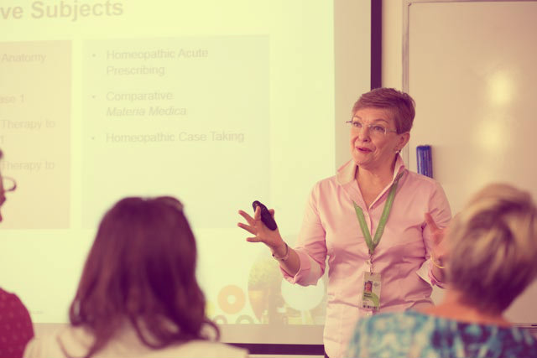
Positive Outcomes.
of 10

Slide 7
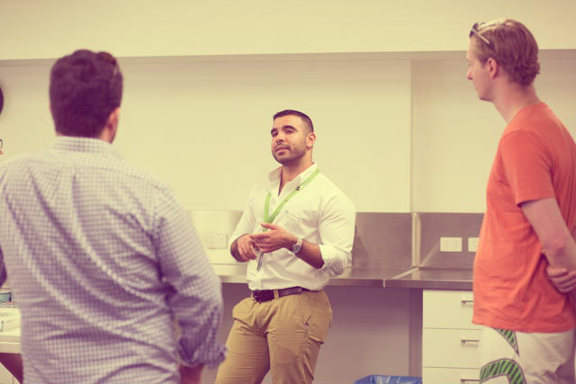
Continued
resourcing.
of 10

Slide 8

Areas of improvement.
of 10

Slide 9

Evidence of success.
of 10

Slide 10

of 10

